Slide 1
ME759 High Performance Computing for Applications in Engineering [Spring 2020]
Lecture 12
02/19/2019
Dan Negrut, 2020 ME759 UW-Madison

Slide 2
Quote of the day
“You don't need a weatherman to know which way the wind blows.”
-- Bob Dylan, singer-songwriter, author, and visual artist [ 1941- ].

Slide 3
Student Feedback quotes of the day [Fake]
“You are the best. We really like you a lot.”
“Esti cel mai tare.”
“You are smarter than all other faculty at UW-Madison. Combined.”
“You hair style is amazing. Thank you!”
“I wish I could speak English with your accent.”
2020 ME759 anonymous feedback

Slide 4
Before we get going…
Last time:
Wrapped execution configuration
Example: Volta V100
2048 threads in flight per SM for 100% occupancy
Up to 84*2048= 172,032 can be in flight at one instance in time
The GPU memory ecosystem
Register, local, cache, shared, global, constant, texture
Today:
Wrap up memory ecosystem
Shared memory issues
Good global memory accesses
Other tidbits:
Assignment due on Friday at 9 pm
Please read assigned readings
Some docs are long, I know – good to have on your radar
From now on, Dan has office hours online in Canvas each Wd at 7 PM
Next time:
Quick discussion about Final Project proposal
Touch on some points you raised in your feedback

Slide 5
3 Ways to Set Aside Shared Memory
First way: Statically, declared inside a kernel
See matrix multiplication example w/ shared memory use
Second way: Through the execution configuration
Ns below indicates size (in bytes) to be allocated in shared memory
__global__ void MyFunc(float*) // __device__ or __global__ function
{
extern __shared__ float shMemArray[];
// Size of shMemArray determined through the execution configuration
// You can use shMemArray as you wish here…
}
// invoke like this
MyFunc<<< Dg, Db, Ns >>>(parameter);
Third way: Dynamically, via CUDA Driver API
Advanced feature, uses API function cuFuncSetSharedSize(), not discussed here

Slide 6
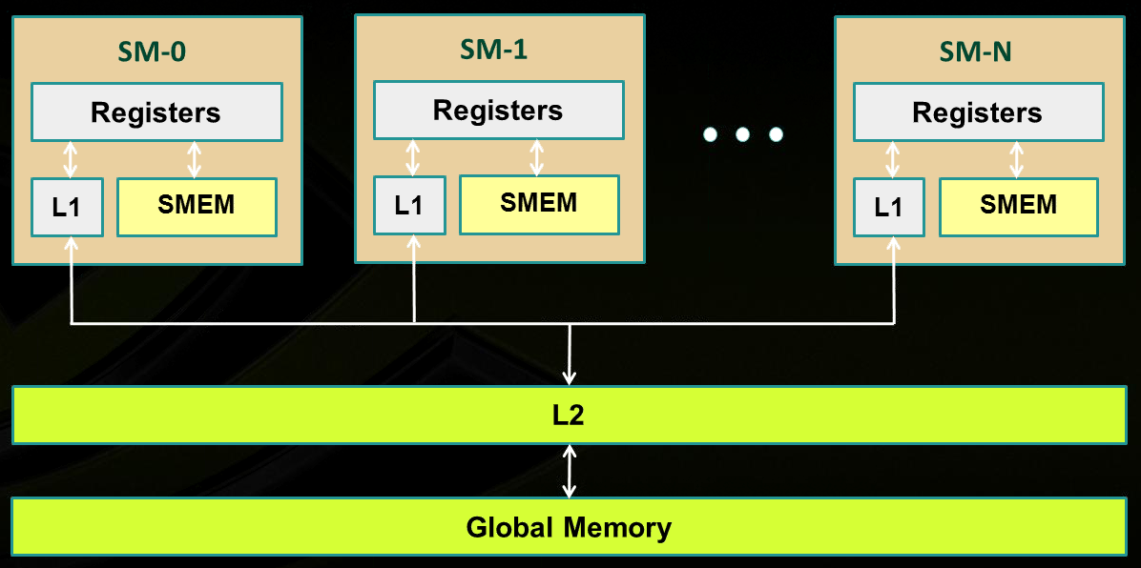
Memory Layout, Fermi and more recent architectures
SM₀
SM₁
SM_{N-1}
NVIDIA→
Notes:
Illustration of caches intermediating global memory access.
Recall: shared memory is not cached

Slide 7
GPU Cache Line
All global memory accesses are cached
A cache line is 128 bytes
It maps to a 128-byte aligned segment in device memory
Note: it so happens that 128 bytes = 32 (warp size) * 4 bytes
In other words, 32 floats or 32 ints fit in one cache line (and can be brought in L2 or L1 in one trip)
If the size of the type accessed by each thread is more than 4 bytes, a memory request by a warp is first split into separate 128-byte memory requests that are issued independently
Notes:
What is important about a cache line of 128 bytes?
it maps well in a data transaction for an entire warp: 32 floats or 32 ints
in one operation services all threads in a warp
You can determine at *compile* time (through flags: -dlcm=ca/cg) if you double cache [L1 & L2] or only cache [L2 only]
If [L1 & L2], a memory access is serviced with a 128-byte memory transaction
If [L2 only], a memory access is serviced with a 32-byte memory transaction
This can reduce over-fetch in the case of scattered memory accesses
Good for irregular pattern access (sparse linear algebra)

Slide 8
L1 & L2 Cache Issues [two slide detour – 1/2]
L1 and L2 cache used to cache accesses to
Local memory
Global memory
(texture & constant as well)
L2 cache (Volta): 6144 KB – one big pool available to *all* SMs on the device
Whether reads are cached in [L1 & L2] or in [L2 only] can be partially configured on a per-access basis using modifiers to the load or store instruction
Notes:
Recalling some numbers for a particular card (Fermi).
On all recent cards, all memory transactions are intermediated by the cache.
Size of cache line: 128 bytes
You can determine at *compile* time (through flags: -dlcm=ca/cg) if you double cache [L1 & L2] or only cache [L2 only]
If [L1 & L2], a memory access is serviced with a 128-byte memory transaction
If [L2 only], a memory access is serviced with a 32-byte memory transaction
This can reduce over-fetch in the case of scattered memory accesses
Good for irregular pattern access (sparse linear algebra)

Slide 9
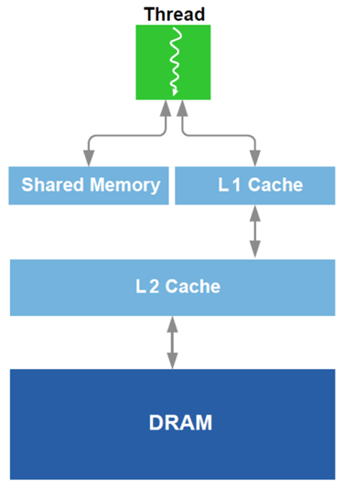
L1 Cache vs. Shared Memory [two slide detour – 2/2]
Starting w/ Fermi architecture, you can split some fast memory between shared memory and cache
Example, Fermi: you can go 48/16 or 16/48 KB for Shared Mem/Cache
OPTION 1: you choose to go w/ “Lots of Cache & Little Shared Mem”
Cache handled for you by the scheduler
No control over it
Can’t have too many blocks of threads running if blocks use Shared Mem
OPTION 2: you choose to go w/ “Lots of Shared Mem & Little Cache”
Good in tiling, you have full control
Shared Mem pretty cumbersome to manage
Notes:
On Maxwell and Pascal, dedicated shared memory (64) and unified L1 cache (24), per SM
Pre-Pascal, the L1 cache / ShMem split can be done at runtime, or through compiler option
One last note about specifying use of shared memory for a block:
statically, declared in the kernel function using the keyword __shared__ like we did before
specify requirements through the execution configuration: __global__ void my_kernel(…) { extern __shared__ float As[]; // size is Ns bytes … } my_kernel<<< grid_dim , block_dim , Ns >>> (…);
dynamically, through the CUDA driver API (low-level) cuFuncSetSharedSize();
Note: as of Fermi, no direct access to shared memory. May need to use volatile to prevent the compiler from optimizing by using registers! Not needed here because __syncthreads already has memory-fencing built-in (i.e. the registers are evicted back to shared memory at that point)

Slide 10
On the architecture of the GPU’s Shared Memory [1/2]
GPU computing: many threads access the ShMem at the same time
To service more than one thread, ShMem is divided into independent banks
This layout essential to achieve high bandwidth
Each SM has ShMem organized in 32 Memory banks
Successive 32-bit words map to successive banks
Each bank has a bandwidth of 32 bits per clock cycle
Bank 0
Bank 1
Bank 2
Bank 3
Bank 4
Bank 5
Bank 6
Bank 7
Bank 31

Slide 11
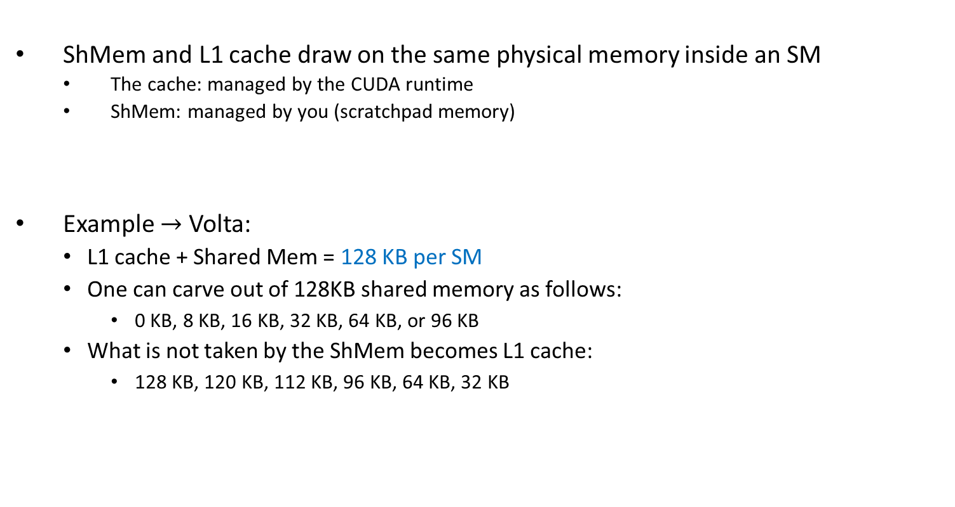
On the architecture of the GPU’s Shared Memory [1/2]
ShMem and L1 cache draw on the same physical memory inside an SM
The cache: managed by the CUDA runtime
ShMem: managed by you (scratchpad memory)
Example $→$ Volta:
L1 cache + Shared Mem = 128 KB per SM
One can carve out of 128KB shared memory as follows:
0 KB, 8 KB, 16 KB, 32 KB, 64 KB, or 96 KB
What is not taken by the ShMem becomes L1 cache:
128 KB, 120 KB, 112 KB, 96 KB, 64 KB, 32 KB
Bank 0
Bank 1
Bank 2
Bank 3
Bank 4
Bank 5
Bank 6
Bank 7
Bank 31

Slide 12
On the architecture of the GPU’s Shared Memory [2/2]
The 32 ShMem banks organized like benches in a movie theater
You have multiple rows of benches
Each row has 32 benches separated; each bench belongs to a long column
A bank: a column of benches in the movie theater, perpendicular to screen
In each bench you can “seat” a family of four bytes (32 bits total)
Each bank has a bandwidth of 32 bits per two clock cycles
I
$
There are 32 columns of benches (banks);
each column is very deep (many benches)
L
1
Bank 0
Multithreaded
Bank 1
Instruction Buffer
Bank 2
Bank 3
screen of the movie theater
Bank 4
R
D
$
Shared
Bank 5
F
L
1
Mem
Bank 6
Bank 7
Operand Select
Bank 31
MAD
SFU

Slide 13
Shared Memory: Transaction Rules & Bank Conflicts
When reading in four-byte words, 32 threads in a warp attempt to access shared memory simultaneously
Bank conflict: two different threads access *different* words in different rows of the same bank
Note that there is no conflict if different threads access any bytes within the same word (same row)
Bank conflicts enforce the hardware to serialize a ShMem access, which adversely impacts bandwidth

Slide 14
Shared Memory Bank Conflicts
If there are no bank conflicts:
Shared memory access is fast, but not quite as fast as register access
On the bright side, latency is roughly 100x lower than global memory latency
ShMem operation, the fast case:
If all threads of a warp access different banks, there is no bank conflict
If all threads of a warp access an identical address for a fetch operation, there is no bank conflict (broadcast)
ShMem memory operation, the slow case:
Worst case: 32 threads access 32 different words in the same bank
Must serialize all the accesses
In general, cost = max # of simultaneous accesses to a single bank

Slide 15
Example: How Addresses Map to Banks, for array of float
An allotted chunk of shared memory starts at an address that is at least a multiple of 128 (if not 256)
Bank you work with = (address of offset) % 32
Example: 1D shared mem array, myShMemVar, of 1024 floats
myShMemVar[4]: accesses bank #4 (physically, the fifth one – first row)
myShMemVar[31]: accesses bank #31 (physically, the last one – first row)
myShMemVar[50]: access bank #18 (physically, the 19th one – second row)
myShMemVar[128]: access bank #0 (physically, the first one – fifth row)
myShMemVar[178]: access bank #18 (physically, the 19th one – sixth row)
If, for instance, the third thread in a warp accesses myShMemVar[50] and the eight thread in the warp accesses myShMemVar[178], then you have a two-way bank conflict and the two transactions get serialized
IMPORTANT: There is no such thing as “bank conflicts” between threads belonging to different warps

Slide 16

Bank Addressing Examples Transactions Involving 4 Byte Words
No Bank Conflicts
Linear addressing stride == 1
No Bank Conflicts
Random 1:1 Permutation
Thread 0
Bank 0
Thread 0
Bank 0
Thread 1
Bank 1
Thread 1
Bank 1
Thread 2
Bank 2
Thread 2
Bank 2
Thread 3
Bank 3
Thread 3
Bank 3
Thread 4
Bank 4
Thread 4
Bank 4
Thread 5
Bank 5
Thread 5
Bank 5
Thread 6
Bank 6
Thread 6
Bank 6
Thread 7
Bank 7
Thread 7
Bank 7
Thread 31
Bank 31
Thread 31
Bank 31
[NVIDIA]$→$

Slide 17
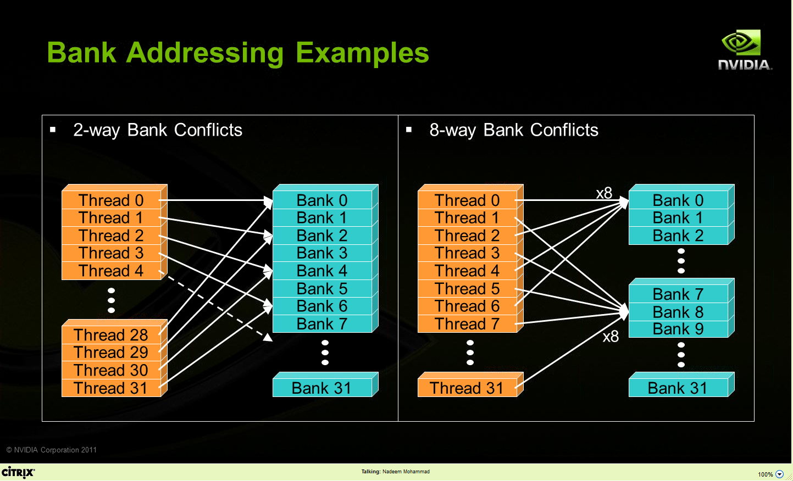
Bank Addressing Examples Transactions Involving 4 Byte Words
A case in which only the even banks end up being accessed, and the warps access different words in each bank
A case in which the 32 threads in a warp access only banks 0, 8, 16, and 24 (and different words in these four banks)
[NVIDIA]$→$

Slide 18
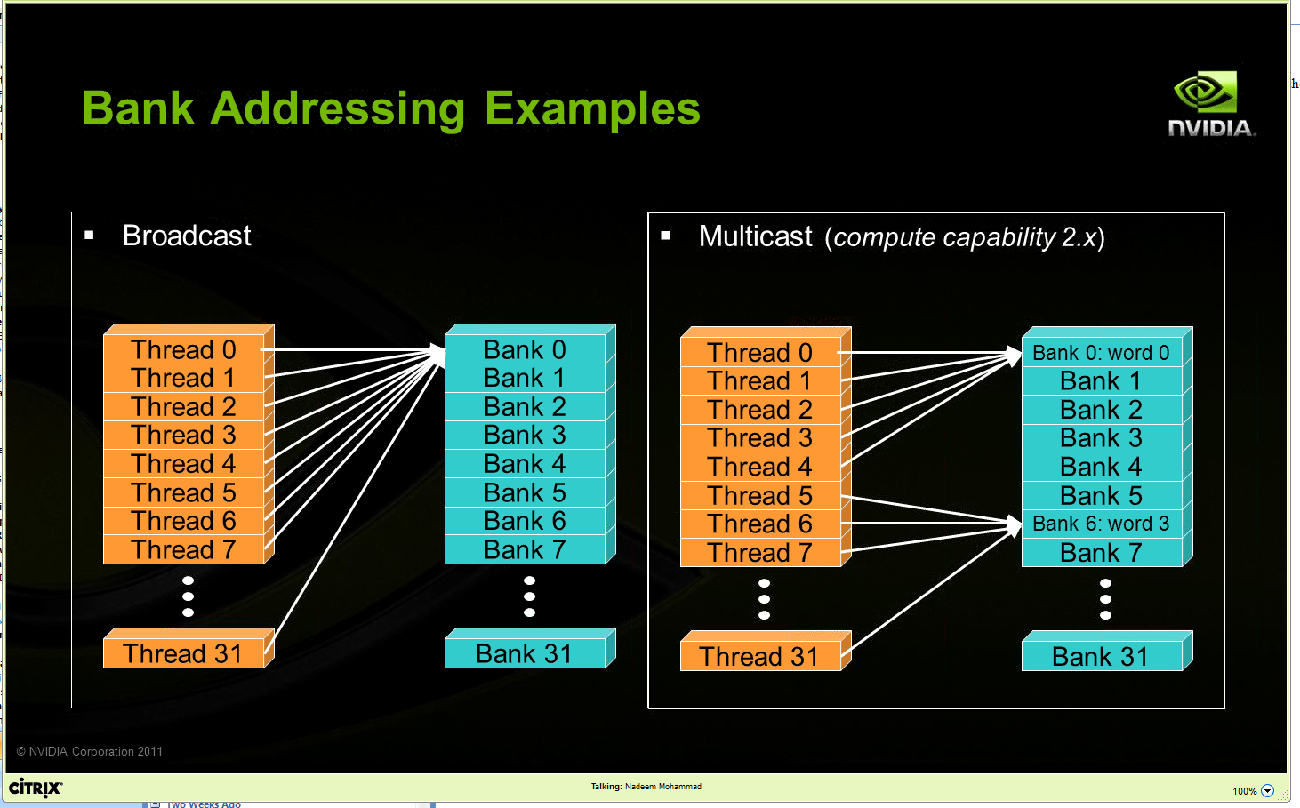
Other Examples
Two “no conflict” scenarios, reading operations:
Broadcast: all threads in a warp access the same word in a bank
Multicast: several threads in a warp access the same word in the same bank

Slide 19
Linear Addressing
Given:
__shared__ float sharedM[256];
float foo = sharedM[baseIndex + s * threadIdx.x];
This is bank-conflict-free if s shares no common factors with the number of banks
Conclusion: you are fine if s is odd
s=1
s=3
Thread 0
Bank 0
Thread 0
Bank 0
Thread 1
Bank 1
Thread 1
Bank 1
Thread 2
Bank 2
Thread 2
Bank 2
Thread 3
Bank 3
Thread 3
Bank 3
Thread 4
Bank 4
Thread 4
Bank 4
Thread 5
Bank 5
Thread 5
Bank 5
Thread 6
Bank 6
Thread 6
Bank 6
Thread 7
Bank 7
Thread 7
Bank 7
Thread 31
Bank 31
Thread 31
Bank 31
Note: baseIndex assumed 0 (zero) in these two pics

Slide 20
Data types and bank conflicts
No conflicts if shrd is a 32-bit data type:
foo = shrd[baseIndex + threadIdx.x]
Also if accessing one byte-per-thread, no conflict since *different* bytes of the same word are accessed
No conflicts:
extern __shared__ char shrd[];
foo = shrd[baseIndex + threadIdx.x];
No conflicts:
extern __shared__ short shrd[];
foo = shrd[baseIndex + threadIdx.x];
Thread 0
Bank 0
Thread 1
Bank 1
Thread 2
Bank 2
Thread 3
Bank 3
Thread 4
Bank 4
Thread 5
Bank 5
Thread 6
Bank 6
Thread 7
Bank 7
Thread 31
Bank 31
Thread 0
Bank 0
Thread 1
Bank 1
Thread 2
Bank 2
Thread 3
Bank 3
Thread 4
Bank 4
Thread 5
Bank 5
Thread 6
Bank 6
Thread 7
Bank 7
Thread 31
Bank 31

Slide 21
Exercise: Is ShMem access below good or bad?
Snippet from a kernel, each thread loads two floats into ShMem:
This makes sense for traditional CPU threads, locality in cache line usage and reduced sharing traffic
Doesn’t make sense in shared memory usage where there is no cache line effects but banking effects
2-way-interleaved loads result in 2-way bank conflicts
Adding insult to injury: you don’t have coalesced global memory loads – basically you are halving the device mem bandwidth (more on this later)
int tid = threadIdx.x;
shared[2*tid ] = global[offset+2*tid ];
shared[2*tid+1] = global[offset+2*tid+1];
Thread 0
Bank 0
Thread 1
Bank 1
Thread 2
Bank 2
Thread 3
Bank 3
Bank 4
Bank 5
Bank 6
Bank 7
Thread 16
Thread 17
Thread 18
Thread 19
Bank 31
Notes:
What is “cache line effects”?

Slide 22
A better array access pattern: Revisiting example on previous slide
Thread 0
Bank 0
Here’s a better way of doing it
Each thread loads one element in every consecutive group of blockDim elements.
Thread 1
Bank 1
Thread 2
Bank 2
Thread 3
Bank 3
shared[tid] = global[offset + tid];
shared[tid + blockDim.x] = global[offset + tid + blockDim.x];
Thread 4
Bank 4
Thread 5
Bank 5
Thread 6
Bank 6
Thread 7
Bank 7
Thread 31
Bank 31

Slide 23
Global Memory Access Issues
Notes:
Numbers related to this change from card to card, but there are some common principles.
Memory size keeps increasing (6GB on Fermi, 12 on Kepler, 16 on Pascal)
Memory clock speed (Fermi: 2GHz, Kepler: 2.5GHz, Pascal: 2GHz for each HBM2 stack)
Memory interface (384-bit GDDR5 on Fermi, Kepler, Maxwell, up to 4096-bit on Pascal)
Bandwidths keep increasing (~170 GB/s on Fermi, 720 GB/s on Pascal)
Peak bandwidth: (f * 1e9) * (b / 8) * 2 → in B/s b/8 → bytes
2 → two copy engines
Effective bandwidth of code: (Br + Bw)/time → in B/s

Slide 24
CUDA Device Memory Allocation/Deallocation
(Device) Grid
Block (0, 0)
Block (1, 0)
cudaMalloc()
Allocates mem in the device Global Memory
Requires two parameters
Address of a pointer to the allocated object
Size of allocated object
cudaFree()
Frees mem from device Global Memory
Requires a pointer to freed object
Shared Memory
Shared Memory
Registers
Registers
Registers
Registers
Thread (0, 0)
Thread (1, 0)
Thread (0, 0)
Thread (1, 0)
Local
Memory
Local
Memory
Local
Memory
Local
Memory
Host
Global
Memory
Constant
Memory
Texture
Memory

Slide 25
CUDA Host-Device Data Transfer
(Device) Grid
cudaMemcpy()
Memory data transfer
Requires four parameters
Pointer to source
Pointer to destination
Number of bytes copied
Type of transfer
Host to Host
Host to Device
Device to Host
Device to Device
Things happen over a PCIe connection
Up to 16 GB/s (PCIe 3.0 x16, in each direction)
Block (0, 0)
Block (1, 0)
Shared Memory
Shared Memory
Registers
Registers
Registers
Registers
Thread (0, 0)
Thread (1, 0)
Thread (0, 0)
Thread (1, 0)
Local
Memory
Local
Memory
Local
Memory
Local
Memory
Host
Global
Memory
Constant
Memory
Texture
Memory
Notes:
PCIe 4.0 16X (expected 2017) → almost 32 GB/s
NVLink (available on Pascal) → 5-12 times faster than PCIe 3.0

Slide 26
CUDA Host-Device Data Transfer (cont.)
Example:
Transfer a number of “size” bytes
M is in host memory and Md is in device memory
cudaMemcpyHostToDevice and cudaMemcpyDeviceToHost are CUDA-defined constants
cudaMemcpy(Md.elements, M.elements, size, cudaMemcpyHostToDevice);
cudaMemcpy(M.elements, Md.elements, size, cudaMemcpyDeviceToHost);
Note: if you use gdb to debug, don’t expect to be able to read memory off a device pointer
Debugging for GPU computing relies on cuda-gdb
Notes:
Note: copy values in constant memory (from the host) using cudaMemcpyToSymbol
Example:
__device__ __constant__ pivalue;
float foo = 3.14159f;
cudaMemcpyToSymbol(&pivalue, &foo, sizeof(float));

Slide 27
Ruminations, memory related
Looking ahead (today and next lecture), ruminations on two topics
Memory operations, getting the result right (broad discussion, for parallel computing, not only GPU)
Memory operations, getting the result fast (narrower discussion, for GPU computing)

Slide 28
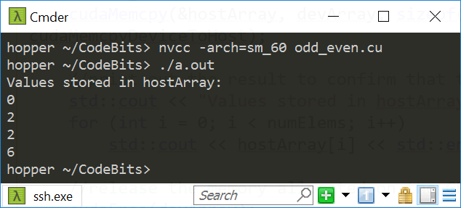
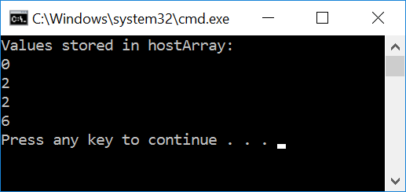
#include<cuda.h>
#include<iostream>
__global__ void odd_even(int* data) {
int i = threadIdx.x;
if ((i & 0x01) == 0)
{
data[i] = data[i] + i; // if even, come here
}
else
{
data[i] = data[i] + 2*i; // come here if you're odd
}
}
int main() {
const int numElems = 4;
int hostArray[numElems], *devArray;
//allocate memory on the device (GPU); zero out all device array entries
cudaMalloc((void**)&devArray, sizeof(int) * numElems);
cudaMemset(devArray, 0, numElems * sizeof(int));
//invoke GPU kernel, with one block that has four threads
odd_even<<<1, 4 >>>(devArray);
//bring the result back from the GPU into the hostArray
cudaMemcpy(&hostArray, devArray, sizeof(int) * numElems, cudaMemcpyDeviceToHost);
//print out the result to confirm that things are looking good
std::cout << "Values stored in hostArray: " << std::endl;
for (int i = 0; i < numElems; i++)
std::cout << hostArray[i] << std::endl;
//release the memory allocated on the GPU
cudaFree(devArray);
return 0;
}
Linux, P100
Windows, GTX1080

Slide 29
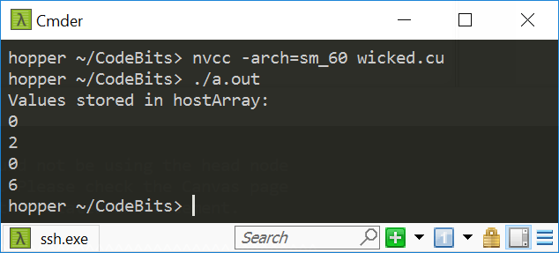
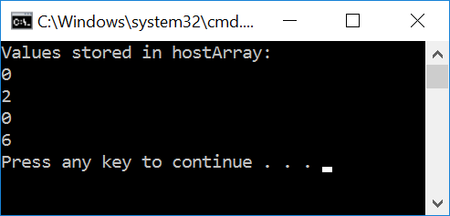
#include<cuda.h>
#include<iostream>
__global__ void wicked(int* data) {
int i = threadIdx.x;
if ((i & 0x01) == 0)
{
data[i+1] = data[i+1] + i; // if even, come here
}
else
{
data[i] = data[i] + 2*i; // come here if you're odd
}
}
int main() {
const int numElems = 4;
int hostArray[numElems], *devArray;
//allocate memory on the device (GPU); zero out all device array entries
cudaMalloc((void**)&devArray, sizeof(int) * numElems);
cudaMemset(devArray, 0, numElems * sizeof(int));
//invoke GPU kernel, with one block that has four threads
wicked<<<1, 4 >>>(devArray);
//bring the result back from the GPU into the hostArray
cudaMemcpy(&hostArray, devArray, sizeof(int) * numElems, cudaMemcpyDeviceToHost);
//print out the result to confirm that things are looking good
std::cout << "Values stored in hostArray: " << std::endl;
for (int i = 0; i < numElems; i++)
std::cout << hostArray[i] << std::endl;
//release the memory allocated on the GPU
cudaFree(devArray);
return 0;
}
Linux, P100
Windows, GTX1080

Slide 30
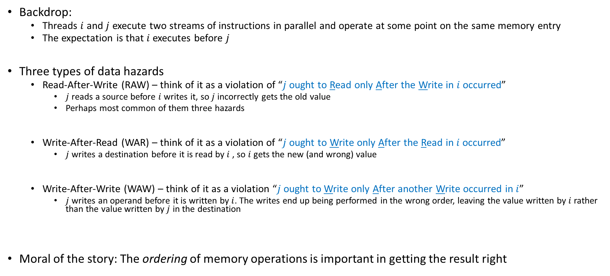
Data Hazards in Parallel Computing
Backdrop:
Threads $i$ and $j$ execute two streams of instructions in parallel and operate at some point on the same memory entry
The expectation is that $i$ executes before $j$
Three types of data hazards
Read-After-Write (RAW) – think of it as a violation of “$j$ ought to Read only After the Write in $i$ occurred”
$j$ reads a source before $i$ writes it, so $j$ incorrectly gets the old value
Perhaps most common of them three hazards
Write-After-Read (WAR) – think of it as a violation of “$j$ ought to Write only After the Read in $i$ occurred”
$j$ writes a destination before it is read by $i$ , so $i$ gets the new (and wrong) value
Write-After-Write (WAW) – think of it as a violation “$j$ ought to Write only After another Write occurred in $i$”
$j$ writes an operand before it is written by $i$. The writes end up being performed in the wrong order, leaving the value written by $i$ rather than the value written by $j$ in the destination
Moral of the story: The ordering of memory operations is important in getting the result right

Slide 31
Parallel computing, bottom line
Parallel computing: previous slide, two threads led to race conditions – in absence of special measures, there is no way to know who executes what and when
A matter of “racing of threads”
“special measures”, example: use of __syncthreads()
Can we at least say something about the order in which memory operations are carried out?
A matter of “sequence of memory ops”, pertains one thread (with side effects when a 2nd thread present)

Slide 32
The concept of “memory consistency”
__device__ volatile int X = 1, Y = 2;
__device__ void writeXY()
{
X = 10;
Y = 20;
}
__device__ void readXY()
{
int A = Y;
int B = X;
}
Backdrop
Thread_1 executes writeXY()
Thread_2 executes readXY()
Question: what values can A and B assume?
For sequential consistency (“strongly-ordered mem. model”), the only possible scenarios are
A=2 and B=1
A=2 and B=10
A=20 and B=10
For weak consistency (“weakly-ordered memory model”), it is possible to have this
A=20 and B=1

Slide 33
Flavors of memory consistency
Sequential consistency: all reads and all writes are in-order
Relaxed consistency: some types of reordering are allowed
Loads can be reordered after loads (for better working of cache coherency, better scaling)
Loads can be reordered after stores
Stores can be reordered after stores
Stores can be reordered after loads
Weak consistency: reads & writes arbitrarily reordered
Programmer expected to step in and use explicit memory barriers if a certain order needed to be observed

Slide 34
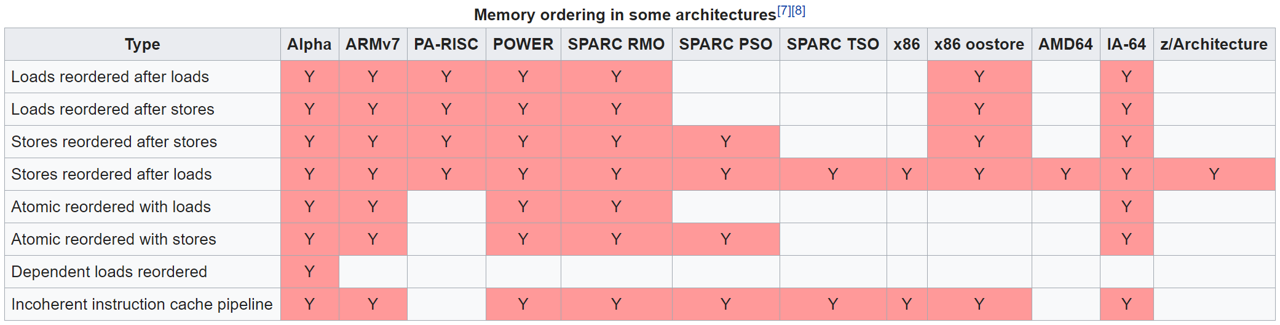

Not a GPU computing but rather a parallel computing issue
Example, memory ordering for some non-GPU architectures
[Wikipedia]$→$

Slide 35
The CUDA __threadfence function, backdrop
What we have just learned:
If a memory transaction was posted, it does not imply that it has been completed before another memory transaction that follows it
Need a guarantee that memory transaction has completed before another one is started
Comes through functionality associated w/ threadfence calls

Slide 36
The CUDA __threadfence family of functions
__threadfence_block();
Execution of the kernel by the calling thread pauses until all global and shared memory outstanding writes are visible to all threads in block
__threadfence();
Execution of kernel by a calling thread ensures all global and shared memory outstanding writes are visible to all threads in block AND all other threads in flight for global data
NOTE: the fences are NOT a synchronization mechanism
Not all threads should reach the fence function for the thread calling the fence to be allowed to move past the fence
It’s just a way to enforce that memory transactions for ONE thread can be seen by other threads

Slide 37
The CUDA __threadfence family of functions
__threadfance_system();
A thread stops in its execution of the kernel until global and shared memory accesses prior to the __threadfance_system() are visible to
all threads in the block for ShMem accesses
all threads in the device for global memory accesses,
host threads for page-locked host memory accesses

Slide 38

The nitty-gritty, has to do with enforcing ordering…
The fine print, for __threadfence_block(), two statements:
All writes to all memory made by the calling thread before the call to __threadfence_block() are observed by all threads in the block of the calling thread as occurring before all writes to all memory made by the calling thread after the call to __threadfence_block()
All reads from all memory made by the calling thread before the call to __threadfence_block() are ordered before all reads from all memory made by the calling thread after the call to __threadfence_block()
Similar semantics for __threadfence() & __threadfence_system()
[NVIDIA CUDA]$→$

Slide 39
#include<cuda.h>
#include<iostream>
__global__ void divergence(int* data)
{
int i = threadIdx.x;
if ((i & 0x01) == 0)
{
data[i+1] = data[i+1] + i; // if even, come here
}
else
{
data[i] = data[i] + 2*i; // if odd, come here
}
}
int main()
{
const int numElems = 4;
int hostArray[numElems], *devArray;
//allocate memory on the device (GPU); zero out all entries in this device array
cudaMalloc((void**)&devArray, sizeof(int) * numElems);
cudaMemset(devArray, 0, numElems * sizeof(int));
//invoke GPU kernel, with one block that has four threads
divergence <<<1, 4 >>>(devArray);
//bring the result back from the GPU into the hostArray
cudaMemcpy(&hostArray, devArray, sizeof(int) * numElems, cudaMemcpyDeviceToHost);
//print out the result to confirm that things are looking good
std::cout << "Values stored in hostArray: " << std::endl;
for (int i = 0; i < numElems; i++)
std::cout << hostArray[i] << std::endl;
//release the memory allocated on the GPU
cudaFree(devArray);
return 0;
}
Linux, P100
Windows, GTX1080

Slide 40
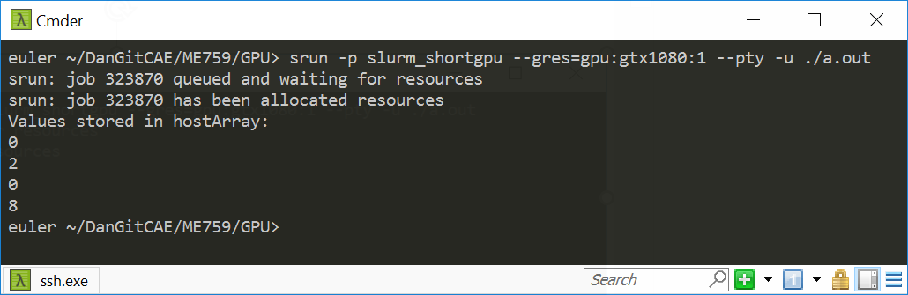
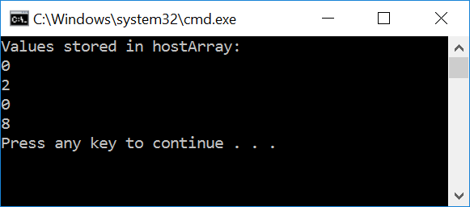
#include<cuda.h>
#include<iostream>
__global__ void divergence(int* data)
{
int i = threadIdx.x;
if ((i & 0x01) == 0)
{
data[i+1] = data[i+1] + i; // if even, come here
__threadfence_block();
}
else
{
data[i] = data[i] + 2*i; // if odd, come here
}
}
int main()
{
const int numElems = 4;
int hostArray[numElems], *devArray;
//allocate memory on the device (GPU); zero out all entries in this device array
cudaMalloc((void**)&devArray, sizeof(int) * numElems);
cudaMemset(devArray, 0, numElems * sizeof(int));
//invoke GPU kernel, with one block that has four threads
divergence <<<1, 4 >>>(devArray);
//bring the result back from the GPU into the hostArray
cudaMemcpy(&hostArray, devArray, sizeof(int) * numElems, cudaMemcpyDeviceToHost);
//print out the result to confirm that things are looking good
std::cout << "Values stored in hostArray: " << std::endl;
for (int i = 0; i < numElems; i++)
std::cout << hostArray[i] << std::endl;
//release the memory allocated on the GPU
cudaFree(devArray);
return 0;
}
Linux, P100
Windows, GTX1080

Slide 41
The volatile qualifier
From CUDA Programming Guide
Compiler is “free to optimize reads and writes to global or shared memory” provided
It respects the memory ordering semantics of memory fence functions
It respects memory visibility semantics of synchronization functions
What is the compiler allowed to do?
Example: store global reads into registers or L1 cache to speed up the computation
These “behind your back” optimizations disabled using the volatile keyword
CUDA: “If a variable located in global or shared memory is declared as volatile, the compiler assumes that its value can be changed or used at any time by another thread and therefore any reference to this variable compiles to an actual memory read or write instruction.”
[CUDA Programming Guide]→

Slide 42
The volatile qualifier: how things go south, ShMem example
To speed execution, compiler places a variable that should make it into ShMem into a register
A register is specific to a thread; another thread cannot see what’s stored in that register
Perhaps your code relies on thread B reading something that was deposited in ShMem by thread A
Thread A’s variable didn’t make it all the way to the ShMem since the compiler wrote that variable in a register, to speed up the computation
volatile prevents the compiler from playing these games and forces any variable to be written to the location in the memory where it ought to be stored – no funny business
Note: if in your kernel you do not expect any thread B to read from ShMem values deposited by thread A, then there is no need to use volatile
Notes:
See also this: https://stackoverflow.com/questions/15331009/when-to-use-volatile-with-shared-cuda-memory

Slide 43
Shared Memory: Historical Fact
It used to be that any access to Shared Memory was a direct access (in compute capability 1.x)
Fermi (2.x) and after: the load/store solution embraced can keep data into registers instead of moving them to ShMem
No guarantee for coherence between the shared memory block and the value stored in the register
Problem is typically addressed by making that shared memory volatile:
In 1.x, this was always ok:
__shared__ int myShVars[256];
Fermi and after, you might have to do this (prevents compiler from optimizing instructions related to myShVars):
volatile __shared__ int myShVars[256];

Slide 44
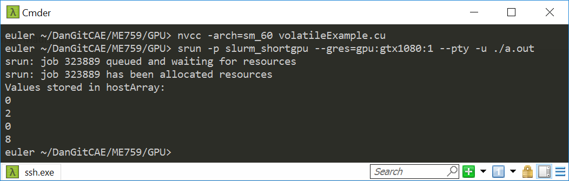

#include<cuda.h>
#include<iostream>
__global__ void divergence(volatile int* data)
{
int i = threadIdx.x;
if ((i & 0x01) == 0)
{
data[i+1] = data[i+1] + i; // if even, come here
}
else
{
data[i] = data[i] + 2*i; // if odd, come here
}
}
int main()
{
const int numElems = 4;
int hostArray[numElems], *devArray;
//allocate memory on the device (GPU); zero out all entries in this device array
cudaMalloc((void**)&devArray, sizeof(int) * numElems);
cudaMemset(devArray, 0, numElems * sizeof(int));
//invoke GPU kernel, with one block that has four threads
divergence <<<1, 4 >>>(devArray);
//bring the result back from the GPU into the hostArray
cudaMemcpy(&hostArray, devArray, sizeof(int) * numElems, cudaMemcpyDeviceToHost);
//print out the result to confirm that things are looking good
std::cout << "Values stored in hostArray: " << std::endl;
for (int i = 0; i < numElems; i++)
std::cout << hostArray[i] << std::endl;
//release the memory allocated on the GPU
cudaFree(devArray);
return 0;
}
Linux, P100
Windows, GTX1080

Slide 45
volatile vs. __threadfence(): how different?
volatile applies equally well to sequential computing
Not an appendage of CUDA, exists in the standard C
__threadfence() specific to parallel computing
Although this particular syntax is specific to CUDA, the idea of a memory fence is not

Slide 46
Landmines everywhere???
Is parallel computing riddled with landmines all over the place?
If same memory location gets accessed by different threads: keep your eyes peeled
Up to you to take necessary steps to ensure proper sequence in memory operations (RAW, WAW, WAR)
The tools of the trade (or “tools of the thread”?):
Use of volatile qualifier
Thread synchronization
Memory fences
Note: this transcends GPU computing, applies equally well to multi-core parallel computing

Slide 47
Ruminations, memory related
Ruminations, on two topics
Memory operations, getting the result right (broad discussion, for parallel computing)
Memory operations, getting the result fast (narrower discussion, for GPU computing)

Slide 48
Memory Access Issues
Issue 1: Not all global memory accesses are equally efficient
How can you optimize memory access?
Question is highly relevant (for fast execution)
Issue 2: Not all shared memory accesses are equally efficient
How can we optimize shared memory accesses?
Moderately relevant question
Discussed already, bottom line: avoid bank conflicts
NOTE: Getting global memory access right has higher priority
Notes:
We discuss the 1st one:
scheduling is important here
We do not discuss the 2nd one:
physical layout of the memory banks used for L1 cache / ShMem
bank conflicts

Slide 49
Data Access “Divergence”
Concept is similar to thread divergence and often conflated
Hardware is optimized for accessing contiguous blocks of global memory when performing loads and stores
“block of global memory”: a 128-byte aligned chunk of 128 byte of memory
Becomes a GPU cache line, once it gets read in L2 (and possibly L1) memory

Slide 50
Global Memory Access
Two aspects of global memory access are relevant when fetching data into shared memory and/or registers
The layout of the access to global memory (the pattern of the access)
The alignment of the data you try to fetch from global memory
IMPORTANT:
The two attributes in red above should be interpreted in the context of a memory transaction carried out by one warp of threads
Notes:
Recall: most programs are memory-bound, flops are cheap
Memory transactions are playing key role in the performance of your code. Getting maximum memory throughput requires you to follow certain access pattern rules.
Data “divergence”: concept similar to thread divergence
hardware is optimized for so-called coalesced memory transactions (accessing contiguous blocks of global memory)
divergence: neighboring threads access memory locations physically far from each other

Slide 51
Comment, on the “layout of the access” attribute
The basic idea:
Suppose each thread in a warp accesses a global memory address for a load operation at some point in the execution of the kernel
These threads can access global memory data that is either (a) neatly grouped, or (b) scattered all over the place
Case (a) is called a “coalesced memory access”
If you end up with (b) this will adversely impact the effective bandwidth of your program
Analogy
It’s one thing to get the timber I need from one forest
Alternatively, in case I need timber from different forests several trips will be in order to get what I need

Slide 52
Comment, on the “alignment” attribute
Fact: Any address of memory allocated in device memory with cudaMalloc is a multiple of 256
The “alignment” component of this story:
It’s a really nice if all threads in a warp access data inside only one memory block

Slide 53
Hitting the jackpot/winning the lottery
Best memory accesses are simultaneously: (1) coalesced and (2) properly aligned

Slide 54
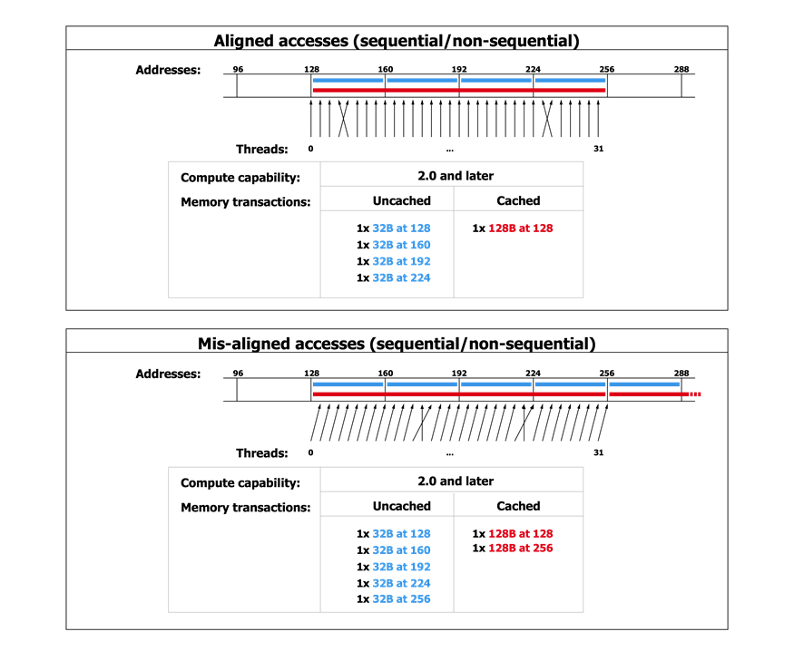
Scenario A: Coalesced and aligned – great!
[NVIDIA]$→$

Slide 55
Scenario B: Coalesced, but not aligned
[NVIDIA]$→$

Slide 56
Why is this important?
In Scenario B you have half the effective bandwidth you get in Scenario A
Just because of the alignment of your data access
If your code is memory bound and dominated by this type of access, you might see a sizeable slow down…
The moral of the story:
When you reach out to fetch data from global memory, visualize how a full warp reaches out for access.
Is the access coalesced and well aligned?

Slide 57
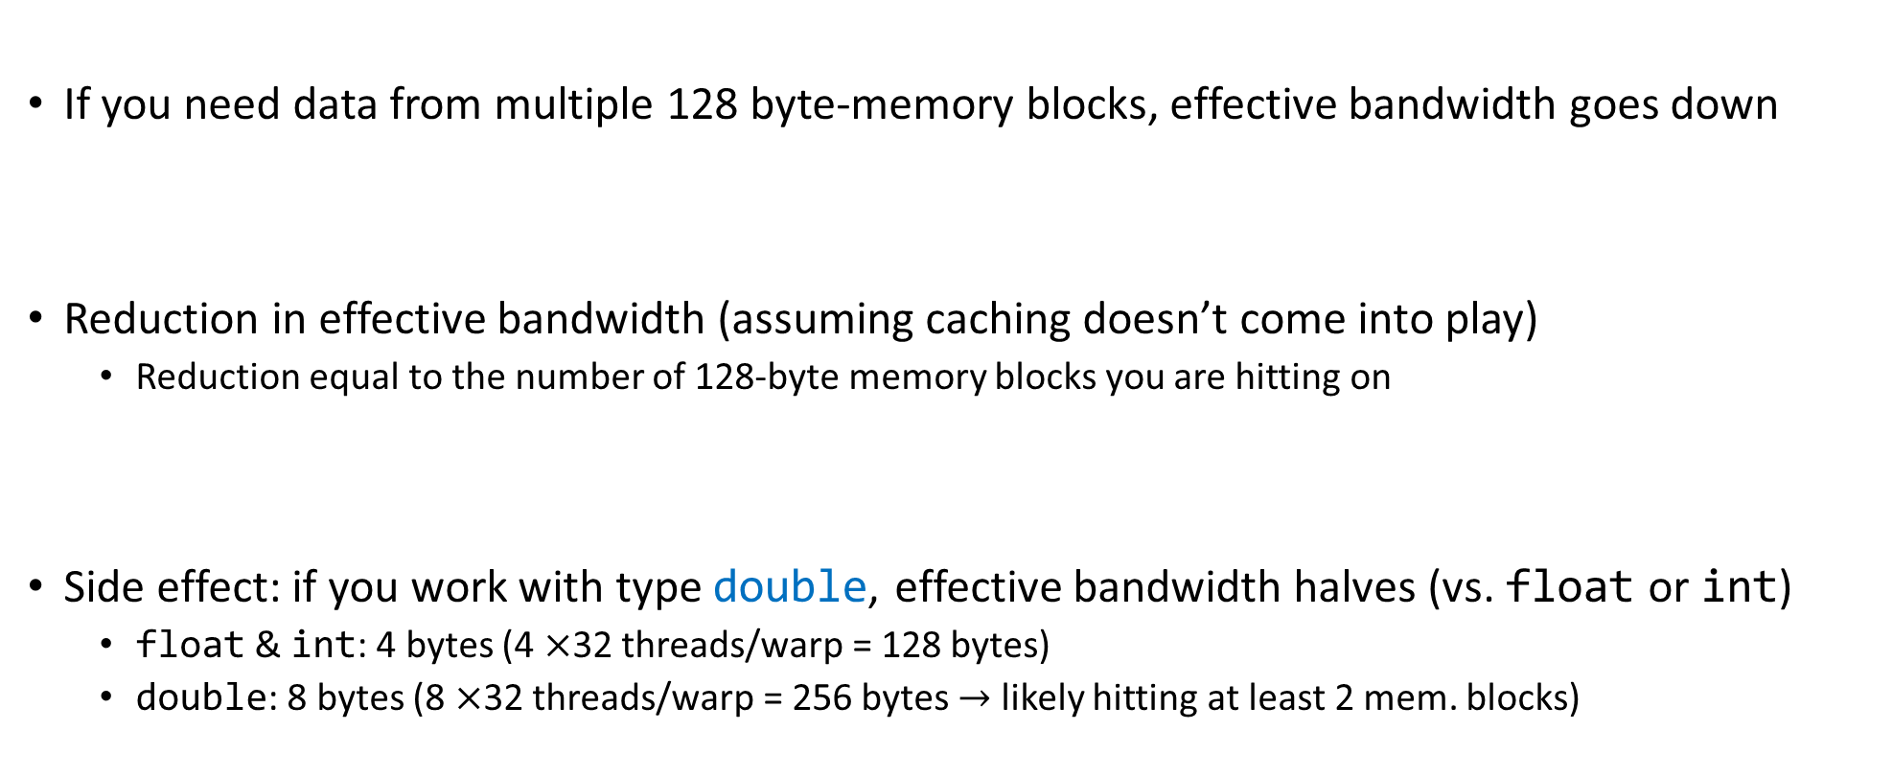
A note on the effective bandwidth
If you need data from multiple 128 byte-memory blocks, effective bandwidth goes down
Reduction in effective bandwidth (assuming caching doesn’t come into play)
Reduction equal to the number of 128-byte memory blocks you are hitting on
Side effect: if you work with type double, effective bandwidth halves (vs. float or int)
float & int: 4 bytes (4 $×$32 threads/warp = 128 bytes)
double: 8 bytes (8 $×$32 threads/warp = 256 bytes $→$ likely hitting at least 2 mem. blocks)

Slide 58
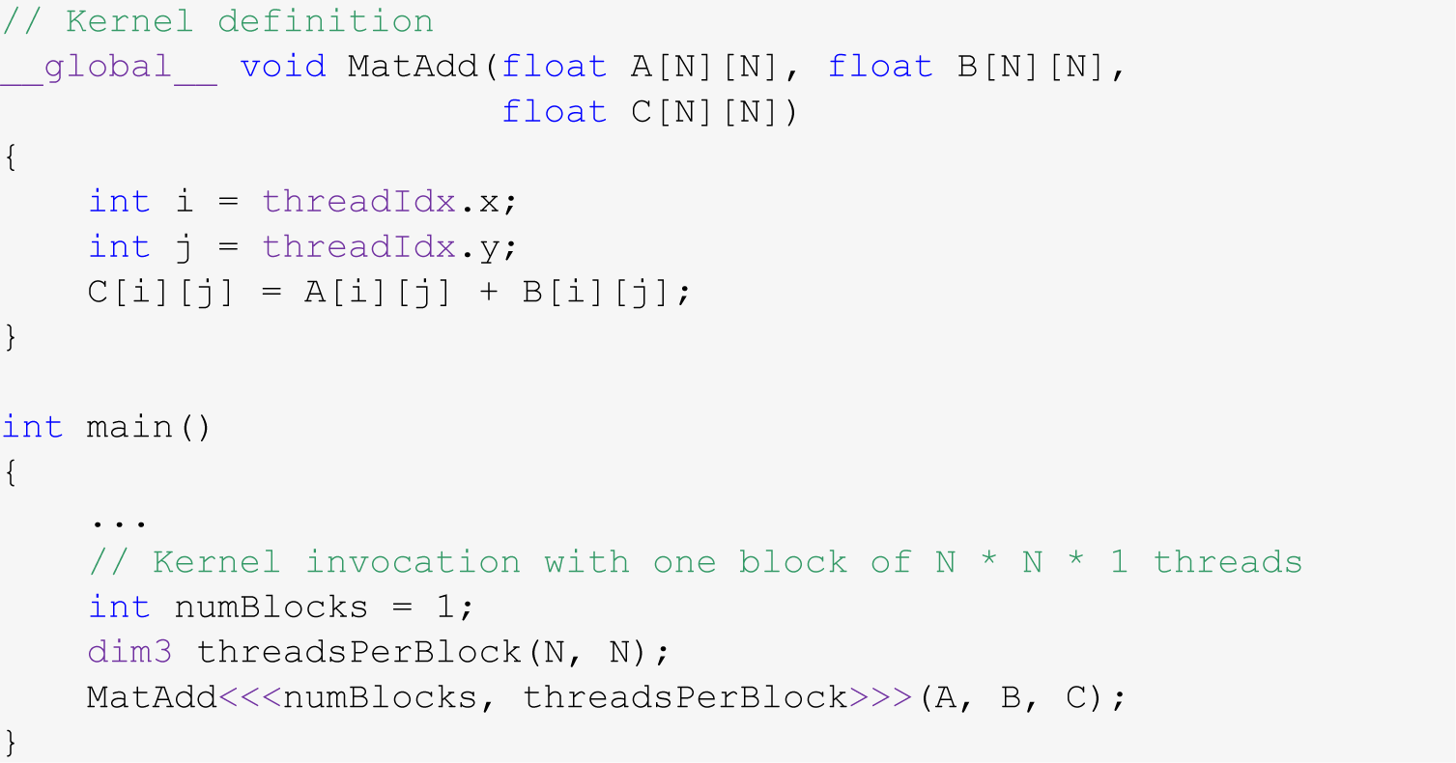
Example: Adding Two Matrices
You have two matrices A and B of dimension NxN (N=32)
You want to compute C=A+B in parallel
Code provided below (some details omitted, such as #define N 32)

Slide 59
Test Your Understanding
Given that the x field of a thread index changes the fastest, is the array indexing scheme on the previous slide good or bad?
HINT: think how threads are mapped into a set of 1D sequence of consecutive IDs
The “good or bad” refers to how data is accessed in the device’s global memory
In other words should we have
or…
C[i][j] = A[i][j] + B[i][j]
C[j][i] = A[j][i] + B[j][i]
Notes:
Mapping threads to data is not unique. Some choices are better than others… (from a memory access point of view)
Must keep in mind how 2-dimensional arrays are stored in C/C++
Answer: C[j][i] = A[j][i] + B[j][i]

Slide 60
Reflecting on Accessing Global Memory in CUDA
Assume dA is a device array, holding ints
Assume z[] is an array of unsigned ints
Which of these accesses are good/bad? Why?
dA[threadIdx.x]
dA[threadIdx.x+2]
dA[3*threadIdx.x+2]
dA[z[threadIdx.x]]
This might be helpful: When answering 1-4 above, imagine you’re a thread and try to understand what the other 31 threads in the warp do when the warp executes some memory instruction
Notes:
Some of these scenarios can lead to out-of-bounds access as well. Particularly the last one

Slide 61
How Do You Avoid Bad Memory Accesses?
Design your data structures in a way that leads to advantageous memory accesses
Choosing a design: done before you write any line of code
Reflect on your algorithm
What data it needs, how much of it, where you read from/write to, how often
A good data structure design for parallel computing is likely different than a good data structure design for sequential computing
I learn programming exclusively thinking about correctness
Then I added convenience
I’m trying now to also factor in speed & legacy/growth & portability
The correctness is a must; then you have to decide on a compromise between convenience, speed, legacy and portability

Slide 62
Related to Data Organization
Say you use in your program complex data constructs that could be organized using C-structures
For GPU computing, how is it more advantageous to store data in global memory?
Alternative A: as an array of structures (AoS)
Alternative B: as a structure of arrays (SoA)
If you use all the data in a struct once you bring over, question not that relevant (although there are aspects that come into play)
However, if you only use one field from a struct, stick w/ SoA
Notes:
Example: 3D points
AoS: Swiss cheese (many holes → wasted trips to memory)
SoA: Parmesan (very dense)

Slide 63
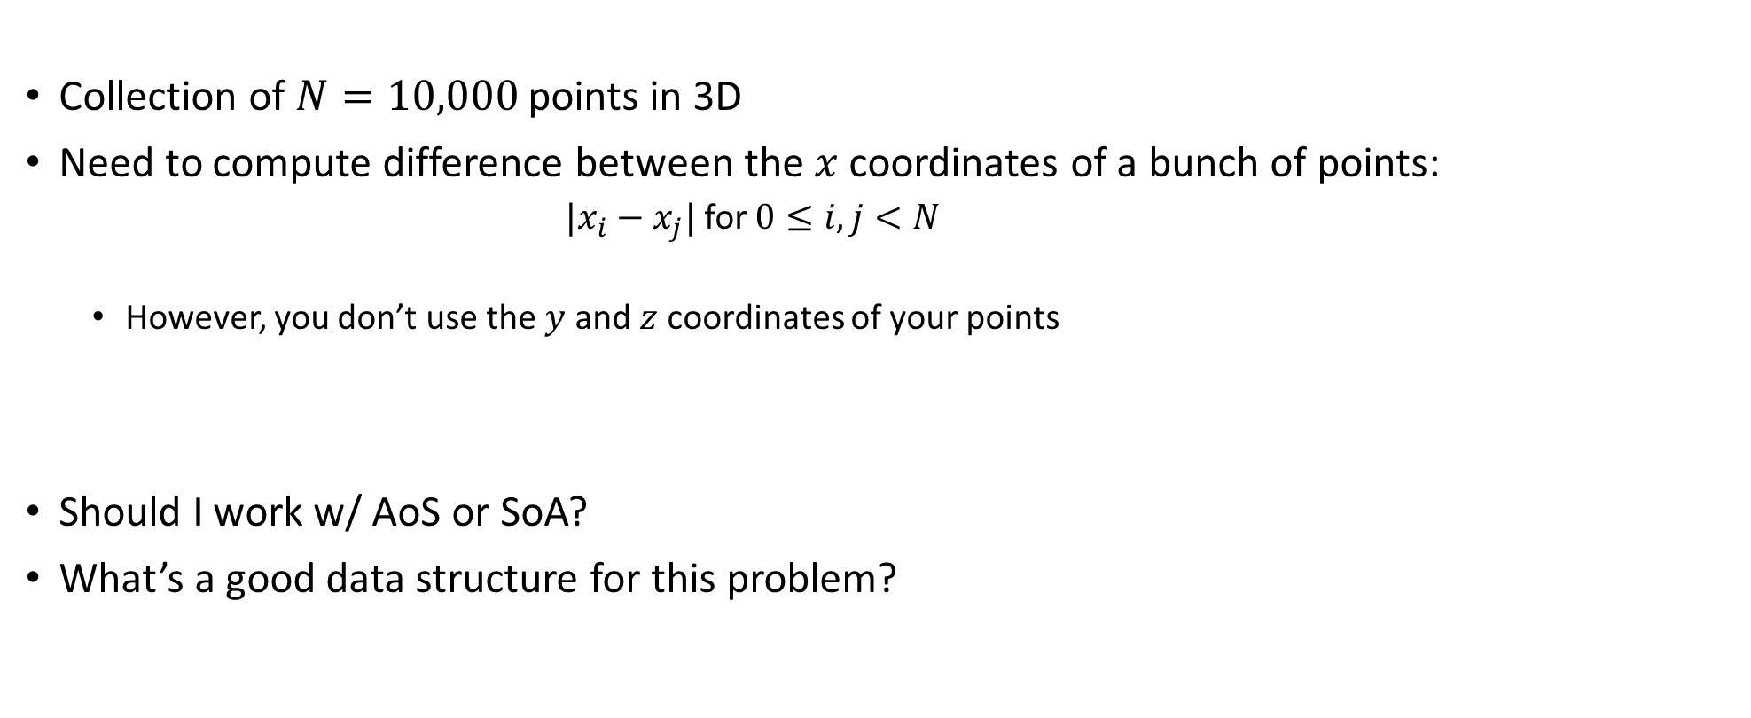
SoA or AoS?
Collection of $N=10,000$ points in 3D
Need to compute difference between the $x$ coordinates of a bunch of points:
${|x}_{i}−x_{j}|$ for $0≤i,j<N$
However, you don’t use the $y$ and $z$ coordinates of your points
Should I work w/ AoS or SoA?
What’s a good data structure for this problem?

Slide 64
Latency vs. Bandwidth, or how the CPU and GPU go about hiding memory access overhead
CPU uses the low latency of the cache to hide memory access overhead
Caches have small latency; bandwidth though is that of the system memory
Why? Caches are small, 256 KB, doesn’t make sense to talk about bandwidth when all you have is 0.000256 GB
GPU hides memory latency by using a combination of two things: SM oversubscription & high bandwidths
Caveat: data needs to find its way into the GPU global memory
PCIe – a good I/O bus, but not a good memory bus
NVLINK: a good memory bus

